Slide 1
How to Access Medicaid Services
Borchard Foundation Training Series – Part III
Marie T. Vaz, Staff Attorney
Peter Travitsky, Staff Attorney
Evelyn Frank Legal Resources Program
212-613-7310 eflrp@nylag.org
http://nyhealthaccess.org April 27, 2016
© NYLAG 2016

Slide 2
Overview
What does it mean to receive services fee-for service?
What does it mean to receive services from a managed care plan?
What are the different Medicaid managed care plans?
How do you access Medicaid services from a managed care plan?

Slide 3
What services does Medicaid cover?
Federal Law requires a minimum of services:
Hospital services
Physician services
Laboratory services
Nursing home care
For children: Early and Periodic Screening and Diagnostic Services (“EPSDT”) 42 CFR §441 Subpart B
Services must be provided in an amount, duration, and scope sufficient to achieve their purpose
Services must be provided with reasonable promptness
Services for one group or area must be comparable to what others receive
42 USC §1396a

Slide 4
What services does Medicaid cover?
Our New York State Medicaid plan covers many more services when they are medically necessary:
Physical, Occupational, Speech therapy
Mental health
Prescription and over-the-counter medication
Dental
Vision
Non-emergency transportation
Long-term care services (example: home care)
Federal Law allows New York to provide additional services to certain populations through approved waivers:
OPWDD, Care at Home, Traumatic Brain Injury, and Nursing Home Transition and Diversion, Managed Long Term Care
https://www.health.ny.gov/regulations/state_plans/ http://www.health.ny.gov/regulations/state_plans/status/

Slide 5
Medicaid is the “payer of last resort”
You must identify if your client has other health insurance that covers a service in full or in part. That insurance must be billed before Medicaid. 42 CFR Part 433 Subpart D.
Third-party health insurance through employer/union or family member’s employer/union
Medicare
Original Medicare
Medicare Advantage
Once Medicaid pays towards a service that is payment in full and the beneficiary cannot be billed
Medicaid provider manuals are a helpful resource to understand when services are covered/billed: www.emedny.org/ProviderManuals/index.aspx

Slide 6


Payment for Medicaid services:
Fee-For-Service
Managed Care
Government Health Program
Government Health Program
Managed Care Plan
Hospitals
Doctors
Other Providers
Hospitals
Doctors
Other Providers

Slide 7
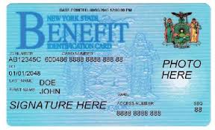
What is fee-for-service?
In regular or fee-for-service Medicaid, beneficiaries can go to any doctor who takes Medicaid. This is called fee-for-service because the doctor or provider gets a fee every time they provide a service to a Medicaid beneficiary.
Fee-for-service Medicaid beneficiaries would use the same “CBIC” card they use for SNAP and Public Assistance to access services:
To receive long-term care, they would be asking for it directly from the County or State via prescribed forms
NYC info: http://www.wnylc.com/health/entry/176/
Rest of State: http://www.wnylc.com/health/entry/39/

Slide 8

What is a managed care plan?
A private health insurance plan paid a fixed amount per member to authorize, pay for and provide services.
Enrollees must follow the plan’s rules, such as:
Choosing a Primary Care Physician (“PCP”)
Obtaining referrals to specialists
Seeking prior authorization for services
Seeing in-network providers
Plan formulary for prescription drugs
Benefit package: Which services are covered depends on type of plan but must be in same amount, duration, scope as fee-for-service
Use plan card to access package services
: 123456ABC
MetroWellHealthChoiceCare
Managed Care Plan
John Doe
Member ID: 123456ABC

Slide 9
 | Fee for Service | Managed Care
Who does Medicare or Medicaid pay? | Pays each provider fee for each service rendered | Pays flat monthly fee (capitation) to insurance plan
Who does provider bill? | Provider bills Medicare or Medicaid directly | Bills the managed care plan, which pays from the a monthly capitation rate from Medicare or Medicaid
Providers available | Any provider who accepts the insurance (e.g. Medicare) | Only providers in the insurance plan’s network
Permission needed for services? | Sometimes. In Medicaid, need approval for personal care, CDPAP, etc. but not for all medical care. | Often. Plan may require authorization to see specialists, or for many services. May not go out of network.
Policy – incentive to give too much/ too little care? | Incentive to bill for unneces-sary care. But offset when authorization needed for services like Medicaid personal care. | Plan has incentive to DENY services, and keep part of capitation rate for profit.
What package of services is available? | Original Medicare = All Medicare services Fee-for-service Medicaid = All Medicaid services | Package of services may be “partial” (MLTC) or full (MAP = all Medicare and Medicaid services).

Slide 10
Medicaid Redesign
In 2011, NY State legislature adopted recommendations of the Medicaid Redesign Team (“MRT”):
Which benefits would be offered on a fee-for-service basis changed drastically
Very few Medicaid recipients would be exempt or excluded from enrolling in managed care
Services and populations affected by managed care can be found on the State MRT webpage: http://www.health.ny.gov/health_care/medicaid/redesign/supplemental_info_mrt_proposals.htm
MRT 1458: Care Management Population and Benefit Expansion, Access to Services, and Consumer Rights
MRT 90: Mandatory Enrollment Managed Long Term Care

Slide 11
Evolution of Medicaid
Medicaid
Mainstream Medicaid Managed Care
Medicaid
(now “Fee-For-Service”)
Program of All-inclusive Care for the Elderly
MMC
Medicaid Advantage
Managed Long-Term Care
Medicaid Advantage Plus
FFS
11

Slide 12
Managed care plans and what they cover:
Medicare (A, B, D) | Medicaid (medical) | Medicaid (LTC)
Medicare Advantage
Medicaid Advantage
 | Mainstream Medicaid Managed Care (MMC)
 | Health and Recovery Plans (HARPs)
 | HIV Special Needs Plans (HIV SNPs)
 |  | Managed Long-Term Care (partial cap) (MLTC)
Medicaid Advantage Plus (MAP)
Program of All-inclusive Care for the Elderly (PACE)
Fully Integrated Duals Advantage (FIDA)
FIDA IDD

Slide 13
Plans for people with Medicaid
People who have Medicaid only can enroll in:
Mainstream Medicaid Managed Care (mandatory for most)
Essential Plan (per immigration status: LPR < 5 years, PRUCOL)
Health and Recovery Plans (HARPs) (if hi-need behavioral health)
HIV Special Needs Plan (HIV SNP) (if HIV/AIDS or homeless)
People who have Medicare and Medicaid can enroll in:
Medicaid Advantage
Managed Long Term Care (MLTC)
Medicaid Advantage Plus (MAP)
Program for All-Inclusive Care for the Elderly (PACE)
Fully Integrated Dual Advantage (FIDA)
FIDA-IDD

Slide 14
Plans with long-term care services
Personal Care Services, Consumer Directed Personal Assistance Program (“CDPAP”), Certified Home Health Aide (“CHHA”), Private Duty Nursing, Adult Day Care
Only some plans cover long-term care services:
People who have Medicaid only
Mainstream Managed Care
Health and Recovery Plans (HARPs)
HIV SNPs
People who have Medicare and Medicaid
Managed Long Term Care (MLTC)
Medicaid Advantage Plus (MAP)
Program for All-Inclusive Care for the Elderly (PACE)
Fully Integrated Dual Advantage (FIDA)
FIDA-IDD

Slide 15
Comparing different types of plans
Each type of plan varies on these questions:
Who can/must enroll?
How do they enroll/disenroll?
What is covered under the plan’s benefit package?
What remains fee for service?
What if you need long term care services?
How do you request services and appeal requests of services that are not granted?

Slide 16
Plans for PEOPLE WHO HAVE MEDICAID ONLY
Mainstream Medicaid Managed Care
Essential Plan
Health and Recovery Plans (HARPs)
HIV SNPs

Slide 17
Mainstream Managed Care (MMCO)
Most, but not all Medicaid beneficiaries in NY who do not have Medicare and do not have a spend-down must now join a "mainstream" Medicaid managed care plan
Who is in MMC?
4.4 million New Yorkers!
“MAGI” Medicaid – families, children, adults under 65 without Medicare – either applied on NYSOH Exchange (1.7 million) or had Medicaid through LDSS (2.3 million)
Some “non-MAGI” Medicaid – 327,000 SSI recipients who don’t have Medicare (including the elderly and many immigrants)
N.Y. Soc. Servs. L. §364-j (Amended L. 2011 Ch. 59)
18 NYCRR 360-10
http://www.wnylc.com/health/entry/160/

Slide 18
Mainstream Managed Care (MMCO)
Enrollment in MMCO –
After approved for Medicaid on NYSOH or at LDSS, receive mandatory enrollment packets from New York Medicaid Choice, a/k/a Maximus, company contracted to process managed care enrollments and disenrollments
Will be randomly assigned to a plan if they do not choose
Have 90 days from their enrollment date to change plans. If they do not switch within 90 days, they are “locked-in” cannot get out for the following 9 months, unless they have “good cause” to do so
After the lock-in period ends, recipients can change plans for any reason at any time

Slide 19
Who does not have to enroll in MMCO?
Two groups of people do not have to join: people who are exempt and people who are excluded
Exempt: People who can decide if they want to join a MMCO plan
People in TBI/NHTD/OPWDD/Care at Home waivers
People with a chronic condition, in active treatment w/ specialist not in any plan. Limited to 6 months
Excluded: People who cannot join a MMCO plan
People with Medicare or other third party health insurance
People with a spend down
People in hospice
People in a limited Medicaid program (e.g. cancer treatment program)
Some foster children
http://www.wnylc.com/health/entry/160/

Slide 20
What does MMCO cover?
Most Medicaid services are included in the MMCO benefit package, including these recently added: behavioral health, nursing home, home care
Assisted Living, Waiver services are still carved out
Whether you enrolled in Medicaid on the NYSOH or LDSS MMCO benefits are the same!
What if you need long term care services?
Have your doctor complete a M11Q- Medical Request for Home Care form (NYC)
Submit it to your plan (usually to the utilization management team)
Your plan will assess you for home care and must issue you a written authorization or denial
If you are dissatisfied with the plan’s decision, you can appeal
Notes:
*42 CFR 438.210

Slide 21
Essential Plan (EP)
From Part 2 of this series: Starting January 2016, some people who are a Legal Permanent Resident < 5 years or PRUCOL, will be enrolled in EP rather than Medicaid at application/renewal – unless they need home care
The EP covers 10 essential health benefits, as mandated by Federal law 42 USC 18022, NY SSL 369-gg:
Ambulatory Care | Hospitalization
Mental Health, Substance Use disorder services | Prescription drugs
Preventative and wellness and chronic disease management | Rehabilitative and habilitative services and devices
Maternity and newborn care | Emergency services
Laboratory services | Pediatric services

Slide 22
Essential Plan (EP)
Since Medicaid covers more than those 10 benefits, immigrants who are required to enroll in the EP:
Will use their CBIC card for over-the-counter medications and non-emergency transportation
Will use their plan card for dental and vision
When EP immigration status is determined by NYSOH: Prompted to enroll in EP at application/renewal
When immigration status is determined by LDSS: Will be transitioned to NYSOH – Procedure outlined in GIS 16/MA 004* – Notices mailed from LDSS and NYSOH
Remember, people who need long term care are not eligible to enroll in EP but procedure leaves it to individual to bring need to NYSOH/LDSS attention
*http://www.health.ny.gov/health_care/medicaid/publications/gis/16ma004.htm

Slide 23
Health and Recovery Plans (HARPs)
NEW in 2016 - HARPs cover the same services as MMCOs for the same Medicaid-only population, plus special services for people with serious Behavioral Health (BH) conditions:
Enhanced care coordination – Care manager works with providers
Behavioral Health Home and Community Based Services (“BH HCBS”) to help people live independently, get jobs, graduate, meet recovery goals
The State identifies eligible enrollees based on high BH service utilization or functional impairment
Eligible enrollees will receive notice from the State – They can either:
Opt out of HARP – some MMCO’s offering BH services within the plan OR
Will be passively enrolled in the HARP product of their MMCO company or
May enroll in the HARP of another insurance company – By calling NY Medicaid Choice
Currently only available to adults in NYC – Rest of State starts October 2016 – Children in 2017
https://www.omh.ny.gov/omhweb/bho/harp.html
http://www.health.ny.gov/health_care/medicaid/redesign/behavioral_health/

Slide 24
HIV Special Needs Plans (HIV SNPs)
HIV SNPs cover the same services as MMCOs plus special services for people living with HIV/AIDs:
HIV Specialist primary care provider
HIV Care Coordination services
Treatment adherence services
Can include HARP benefits for eligible members
People who (1) are eligible to enroll in a MMCO, (2) live in NYC, and (3) are living with HIV/AIDs or are homeless can enroll in a HIV SNP
Their children can also enroll even if they don’t have HIV/AIDs
If you have Medicaid through the NYSOH, enroll there
If you have Medicaid through your LDSS, enroll by calling NY Medicaid Choice
https://www.health.ny.gov/health_care/managed_care/providers/#model_contracts

Slide 25

Counseling example
Riley has a very sad case and needs your help to apply for Medicaid. Some facts about Riley:
Riley has no other health insurance
Riley has a pending Social Security Disability (“SSD”) appeal
Riley applied for SSD because of serious mental health issues
Because of Riley’s mental health issues:
Riley is homeless
Riley needs supports to find and maintain housing
Riley needs assistance with activities of daily living (“ADLs”) to be safe at home
Riley is a U.S. Citizen
Riley has very low income w/out SSD so no Medicaid spend down
I need health insurance and services.

Slide 26
Riley has a few choices:
Because Riley has Medicaid-only with no spend down, Riley will be required to enroll in a MMCO plan
Since behavioral health and home care was recently carved in to the MMCO package, Riley can get mental health treatment and an aide to assist with ADLs from the MMCO plan
Because Riley is homeless, Riley can enroll in a HIV SNP instead of a MMCO to receive care coordination
As Riley accesses BH services from the MMCO, Riley might become eligible for a HARP
Riley could have help of a care manager and BH HCBS to find and maintain housing and live independently
Riley is a U.S. citizen so will not be enrolled in the EP
Even if wasn’t a U.S. citizen not eligible for EP because needs home care

Slide 27
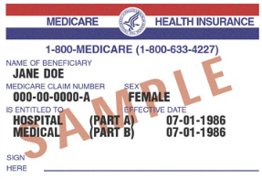


Riley gets Medicare!
Wow. You’re such a great advocate that you got me Medicaid and Medicare…
Riley’s SSD appeal was successful! But, it was pending for two years so Riley started receiving Medicare when the appeal was decided – no 2 year waiting period.
Now Riley has Medicare as primary insurance to Medicaid.
Riley will be disenrolled from the MMCO/HARP/HIV SNP because those plans are for people with Medicaid only
Riley still needs mental health treatment, care management and home care
…But what do I do with these cards?
MetroWellHealthChoiceCare
Medicaid Managed Care Plan BC
Member: Riley
-------------

Slide 28
Plans for PEOPLE WHO HAVE MEDICARE AND MEDICAID
Medicaid Advantage
Managed Long Term Care (MLTC)
Medicaid Advantage Plus (MAP)
Program for All-Inclusive Care for the Elderly (PACE)
Fully Integrated Dual Advantage (FIDA)
FIDA-IDD

Slide 29
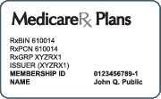
Must all Dual Eligibles Join Managed Care Plans?
No. For MEDICARE, they may choose either:
Option 1: Original Medicare
Part A: Hospital, rehab, home health, hospice
Part B: Doctors, medical equipment, labs, x-rays, mental health, ambulance, PT, and very short term home health
No networks, referrals, or prior authorizations
Standalone Part D: Prescription Drug Coverage
Option 2: Medicare Advantage “Part C”
Covers Parts A, B, sometimes D
Must stay in provider network
Might need referrals and prior
authorizations for services
MediChoice Options Plus
Medicare Advantage w/MedicareRx
John Doe
Member ID: 123456ABC

Slide 30
Must all Dual Eligibles Join Managed Care Plans?
No. For MEDICAID – Most WERE in an MMCO if they had Medicaid before. They will be disenrolled from that MMCO upon getting Medicare. Now:
If they DO NOT need any long-term care, they may use regular Medicaid card FFS as secondary insurance to Medicare. They may also enroll in a Medicare Savings Program.
They have ONE Medicaid managed care option – Medicaid Advantage (next slides)
If they DO need long-term care, they will have to enroll in some Medicaid managed care plan – options will be shown later.
MetroWellHealthChoiceCare
Medicaid Managed Care Plan BC
Member: Riley

Slide 31
Medicaid Advantage
Who must enroll?
NO ONE. Medicaid Advantage is voluntary
Eligibility criteria:
Age 18 or older
Must have full Medicaid with NO SPEND-DOWN (not just the Medicare Savings Program)
Evidence of coverage under Medicare Parts A and B, or Part C
Reside in the plan service area
Who may not enroll? Many people! For complete list see Medicaid Advantage Model Contract 5.2.* Some examples -
Have End Stage Renal Disease
Residents of Residential Health Care Facilities ("RHCF")
Enrolled in managed long term care plan or need Medicaid home care services
Have access to comprehensive private health care coverage, except for Medicare
*http://www.health.ny.gov/health_care/‌managed_care/‌providers/#model_contract

Slide 32
Medicaid Advantage
How do you enroll?
Must enroll in the Medicaid plan’s Medicare Advantage product and same company’s Medicaid managed care product for dual eligibles
How do you disenroll?
Disenroll from company’s Medicare Advantage product OR Medicaid managed care product for dual eligibles
WARNING: Do not disenroll from the Medicare Advantage plan as it could leave client without drug coverage.
Instead, enroll in a plan that offers Medicare prescription drug coverage. This means:
Standalone Medicare Part D plan
A different Medicare Advantage plan that covers drugs, not affiliated with the Medicaid Advantage plan
Enrollment in new coverage will begin the first of the following month

Slide 33
Medicaid Advantage
What is covered under the plan’s benefit package?
Includes all Medicare and Medicaid-covered services EXCEPT Medicaid long-term care (i.e., home care)
DO NOT ENROLL IN THESE PLANS if client needs any Medicaid home care or long term care.
What remains fee for service?
Nothing. Cannot get Medicaid home care FFS any more.
What if you need long term care services? Adults who qualify for Medicare and Medicaid who need long term home care must either:
Enroll in MLTC + Original Medicare + Part D OR
Enroll in FIDA, Medicaid Advantage Plus, or PACE plans.
Doing either #1 or #2 will disenroll client from the MA plan.
May not join an MLTC plan while in a Medicaid Advantage plan.

Slide 34
Enrolling in a plan for duals that includes long term care
GET ME HOME CARE!...and diapers… and DME… and environmental modifications… and dental… and…

Slide 35
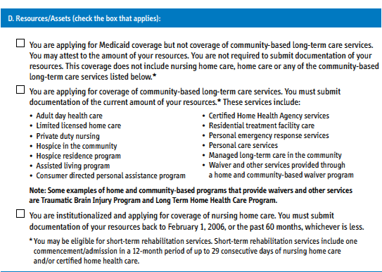
How to Enroll
Document resources as part of Medicaid application.
Use Access NY Supplement A
Submit form and documentation to the LDSS
In NYC it goes to:
HRA HCSP
Central Medicaid Unit 785 Atlantic Ave, 7th Fl Brooklyn, NY 11238 T: 929-221-0849
*Note: If client needs housekeeping only, this benefit is only available through fee-for service Medicaid. Medicaid application and M11q go to:
NYC HCSP Central Intake
109 East 16th Street, 5th Floor
New York, NY 10003
T: 212-824-0706 FAX 212-896-8814

Slide 36
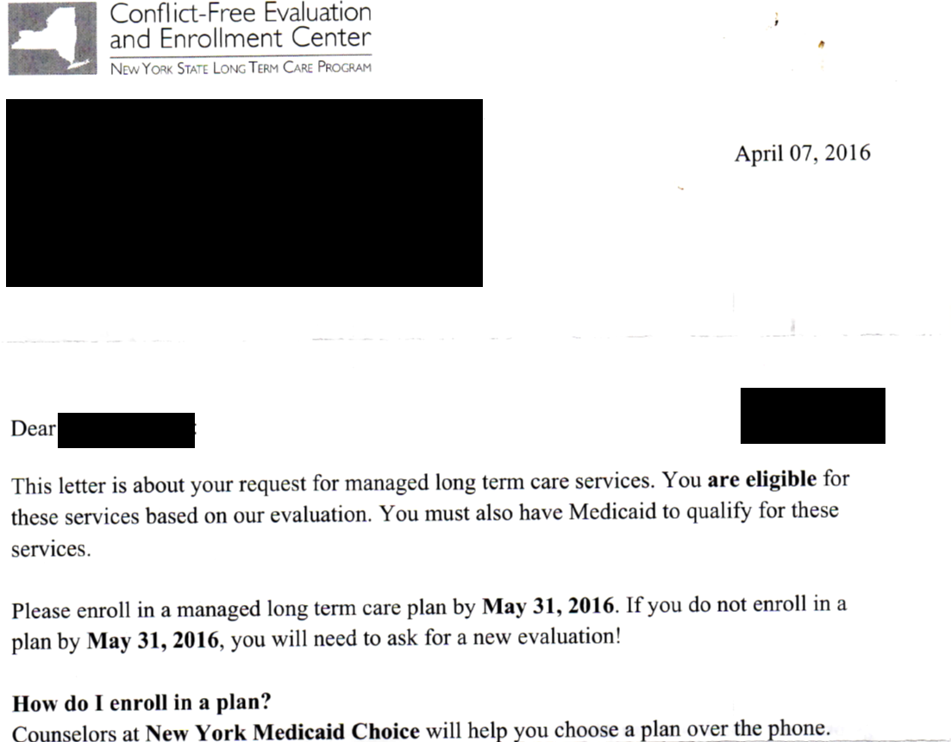
How to Enroll
Schedule an evaluation with the Conflict Free Evaluation and Enrollment Center at New York Medicaid Choice
1-855-222-8350
97% of applicants “pass”
Lots of guidance on the “who, what, where” of CFEEC evaluations available here*
http://www.health.ny.gov/health_care/medicaid/redesign/mrt90/
http://www.wnylc.com/health/afile/202/573/ (NYLAG CFEEC FACT SHEET)

Slide 37
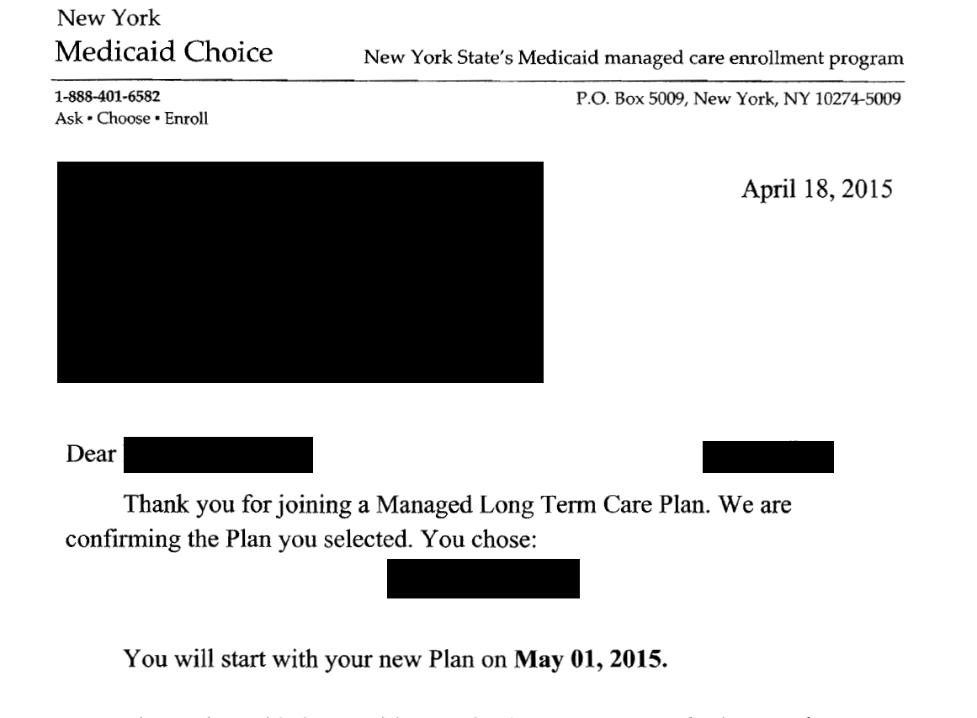
How to Enroll
After the Conflict Free Evaluation you have 60 days to select a plan
Plan lists: https://www.nymedicaidchoice.com/choose/find-long-term-care-plan
Plan assesses you and determines plan of care
Plan must submit your enrollment paperwork to NY Medicaid Choice by the 18th of the month in order for your services to start on the 1st of the following month
90-day transition rights if transitioning from FFS home care
http://www.health.ny.gov/health_care/medicaid/redesign/mltc_policy_13-10.htm
No transition rights if changing plans voluntarily
Conflict Free Evaluation NOT needed when switching between plans

Slide 38
Focus on MLTC
Social Security Act 1115 waiver
https://www.medicaid.gov/medicaid-chip-program-information/by-topics/waivers/waivers_faceted.html
NY Partnership plan
https://www.health.ny.gov/health_care/managed_care/appextension/
Partial Capitation Contract (“MLTC model contract”)
http://www.health.ny.gov/health_care/medicaid/redesign/mrt90/hlth_plans_prov_prof.htm
MRT 90 polices https://www.health.ny.gov/health_care/medicaid/redesign/mrt90/
Medicaid Eligibility
Conflict Free Evaluation
MLTC Plan

Slide 39
MLTC
Who must enroll?
Adults 21+;
Full Medicaid (not just Medicare Savings Program)
Evidence of coverage under Medicare Parts A and B, or Part C, who:
Need CB-LTC for more than 120 days, regardless of possible need for acute inpatient hospitalization or nursing home placement in that time, or
Are nursing home residents on institutional Medicaid permanently placed on or after February 1, 2015 (As of Oct. 1, 2015, enrollment is optional for permanent placements before Feb. 1, 2015)
MLTC Model Contract, Art. IV B.
http://www.health.ny.gov/health_care/medicaid/redesign/mrt90/hlth_plans_prov_prof.htm
Nursing home residents, See 15 ADM-01 at https://www.health.ny.gov/health_care/medicaid/publications/pub2015adm.htm;
See also GIS 16 MA/008 https://www.health.ny.gov/health_care/medicaid/publications/gis/16ma008.htm

Slide 40
MLTC
Who cannot enroll? Many populations! For complete list of exemptions/exclusions, see Art. IV of the Model Contract. Here are some examples:
Expected to be Medicaid eligible for less than six (6) months;
Eligible only for breast and cervical cancer services;
Receiving hospice services at the time of enrollment;*
Eligible for Emergency Medicaid (undocumented immigrant);
In the OPWDD Home and Community Based Services section 1915(c) waiver program;**
In the TBI waiver or the NHTD waiver
Residents of Assisted Living Programs (ALP).
*For consumers who need hospice, see MLTC Policy 13.18 at https://www.health.ny.gov/health_care/medicaid/redesign/mrt90/mltc_policies.htm
**The DD population can enroll in FIDA-IDD, if they are otherwise eligible.

Slide 41
MLTC
What does the plan cover? - “MLTC Benefit Package”
Various types of home care (More than 120 days):
Personal Care (home attendant and housekeeping)
Consumer-Directed Personal Assistance Program (CDPAP)
Home Health Aide, PT, OT (CHHA Personal Care)
Private Duty Nursing
Adult day care – medical & social
Social day care is not available outside of MLTC, MAP, PACE, or FIDA;
Social day care alone is not enough for MLTC; MLTC Policy 13.05 and 13.11*
Medical alert button, home-delivered meals, congregate meals
Durable medical equipment, supplies, prostheses, orthotics, hearing aids, eyeglasses, respiratory therapy, Home modifications
4 doctors—Podiatry, Audiology, Dental, Optometry
Non-emergency medical transportation
Nursing home
*http://www.health.ny.gov/health_care/medicaid/redesign/mrt90/mltc_policies.htm
41
41
41
41
Notes:
Remember to help clients double check with these 4 providers before picking a plan.
For those with Medigap coverage, Medicaid would not be paying the Medicare co-insurance anyway.

Slide 42
MLTC
What remains FFS?
Inpatient and outpatient hospital services
Physician services
Lab services
Radiology and radioisotope services
Emergency transportation
Rural health clinic services
Chronic renal dialysis
Mental health services
Alcohol and substance abuse services
OPWDD services
Family planning services
Prescription, nonprescription, and compounded prescription drugs
Assisted Living Program*
All other services in the State plan
*ALP residents who are duals are currently scheduled to become mandatory on December 1, 2016
but the MLTC model contract and MAP contract list ALP as a non-covered service, while FIDA lists
ALP as a covered service;
See Managed Care Transition timeline
http://www.health.ny.gov/health_care/medicaid/redesign/mrt1458_timeline.htm
MLTC Model Contract Appendix G:
http://www.health.ny.gov/health_care/medicaid/redesign/mrt90/hlth_plans_prov_prof.htm

Slide 43
Transition/Choosing MMC or MLTC
MLTC is mandatory only for DUAL eligibles. Medicaid-only beneficiaries must get their home care from mainstream Medicaid managed care plan. But – they may want to enroll in an MLTC plan instead. There are conditions for doing so:
Must require nursing home level of care (i.e., high hours). But must be pro-active when apply for Medicaid and enroll in an MLTC plan right away –before assigned to MMC. See MLTC Policy 14.01*
Medicaid-only beneficiaries who are already in MMC may transition to MLTC only if they need a service not available in MMC (social day care, home delivered or congregate meals, or social and environmental supports). See MLTC Policy 14.01*
Medicaid-only beneficiaries who become eligible for Medicare must transition to MLTC, See MLTC Policy 15.02*
*http://www.health.ny.gov/health_care/medicaid/redesign/mrt90/mltc_policies.htm

Slide 44
MLTC
What if you need home care?
Request in writing directly to the plan—no special form needed
Type of Request | Plan Must Issue a Decision No Later than…
Expedited | 3 business days from receipt of request; can extend up to 14 calendar days if more info needed
Standard | 14 calendar days from receipt of request; can extend up to 14 calendar days if more info needed
Medicaid covered home health care services following an inpatient admission | 1 business day after receipt of necessary info; when request made the day before a weekend or holiday, no more than 3 business days after receipt of the request for services

Slide 45
Fully Capitated Plans Medicare + Medicaid Services
MAP
PACE
FIDA
FIDA-IDD

Slide 46
Fully Capitated Plans: Common Principles
Payment Structure
Capitation
All of these plans cover Medicare A, B, and D, and Medicaid, including home care
All of these plans are fully capitated, which means that the government pays for all services
CMS and DOH collaborate on implementation
Government Health Plan
Managed Care Plan
Hospital
Doctor
Others

Slide 47
Fully Capitated Plans: Common Principles
The same people who are eligible for MLTC are eligible for fully capitated plans:
Duals, age 21+, who need CBLTC for more than 120 days, regardless of possible need for acute inpatient hospitalization or nursing home placement in that time; or
NH dual-eligible residents on institutional Medicaid
This population MUST be in MLTC to access CBLTC services
Enrollment in a fully capitated plan satisfies this mandate, but is voluntary

Slide 48
Fully Capitated Plans: Common Principles
FIDA is in NYC and Nassau County only - expected to expand to Westchester County and Suffolk County in the second half of 2016
FIDA-IDD is available in the FIDA region AND Rockland County
MLTC, MAP, and PACE are available statewide

Slide 49
Fully Capitated Plans: Common Principles
What services are covered
What services remain FFS
Medicare Part A
Medicare Part B
Medicare Part D
Medicaid
All services in the MLTC benefit package
Directly observed therapy for tuberculosis
Out-of-network family planning services
Methadone maintenance
Hospice
FIDA/MAP—you can remain in the plan but you will access hospice through FFS
PACE—this is a disenrollment - MLTC Policy 13.18(b)

Slide 50
Fully Capitated Plans: Common Principles
Enrollment process is the same as that for MLTC plan
Conflict Free Evaluation
Plan assessment
FIDA-IDD also requires OPWDD waiver eligibility; new enrollees should use the front-door process for the OPWDD waiver*
Plan submission of enrollment paperwork to NY Medicaid Choice
Dual eligibles who transition between plans offering MLTC benefit package DO NOT require a new Conflict Free Evaluation –
MLTC to MLTC
MLTC to fully capitated plan
Fully capitated plan to MLTC (but see next slide)
*http://www.opwdd.ny.gov/opwdd_services_supports/eligibility/faqs

Slide 51
Fully Capitated Plans: Common Principles
When transitioning from a fully capitated plan to MLTC, remember that the fully capitated plan covers Medicare Part D and the MLTC plan does not
Transitioning from fully capitated plan to MLTC may call for TWO enrollments with different enrollment deadlines:
Fully capitated plan → MLTC
Enrollment paperwork must be submitted by the 18th of the month
Fully capitated plan → Part D plan or Medicare Advantage plan that has drug coverage
Any time during the month to be effective 1st of the following month (a dual getting CBLTC through a managed care plan has met her spend down and has active Medicaid coverage, so she has a Special Enrollment Period for Part D)

Slide 52
Focus on Medicaid Advantage Plus (MAP)
Same sources of law as MLTC
Model contract https://www.health.ny.gov/health_care/medicaid/redesign/mrt90/hlth_plans_prov_prof.htm
MRT 90 policies apply to MAP, unless otherwise stated https://www.health.ny.gov/health_care/medicaid/redesign/mltc_policy_13-03a.htm
Medicaid Eligibility
Conflict Free Evaluation
MAP

Slide 53
MAP
Who can enroll?
Age 18 or older
Full Medicaid
Evidence of coverage under Medicare Parts A and B, or Part C
Enroll in the Medicaid plan’s Medicare Advantage product
Require nursing home level of care
Require a service in the MLTC benefit package

Slide 54
MAP
Who cannot enroll? Many people! For complete list of exemptions/exclusions see Medicaid Advantage Plus Model Contract § 5.2. Here are some examples:
Individuals with End Stage Renal Disease
On ESRD and Medicare, see: https://www.medicare.gov/sign-up-change-plans/medicare-health-plans/medicare-advantage-plans/esrd-and-medicare-advantage-plans.html
Individuals who are only eligible for the Medicare Savings Program (QMB, SLIMB, or QI-1)
MSP is not full Medicaid coverage!
Individuals with access to comprehensive private health care coverage, except for Medicare
Probably many reasons for this, but these individuals may not have Medicare Part B

Slide 55
MAP
What does the plan cover?
Medicare A, B, D, Medicaid, and MLTC Benefit Package
Full list of covered and non-covered services is found in Appendix K of the model contract
Examples of non-covered services:
Hospice
Methadone maintenance
Out-of-network family planning
Direct observation therapy for tuberculosis
Certain mental health services
Assisted Living Program
Waiver services
OPWDD services

Slide 56
Focus on PACE
42 CFR Part 460 and Manual https://www.cms.gov/Regulations-and-Guidance/Guidance/Manuals/Internet-Only-Manuals-IOMs-Items/CMS019036.html
Model contract: https://www.health.ny.gov/health_care/medicaid/redesign/mrt90/hlth_plans_prov_prof.htm
MRT 90 policies apply to PACE unless otherwise stated https://www.health.ny.gov/health_care/medicaid/redesign/mltc_policy_13-03a.htm
Enrollment numbers as of Feb. 2016 http://www.integratedcareresourcecenter.net/PDFs/ICRC--PACE%20Program%20Enrollment%20Feb%202016.pdf
Medicaid Eligibility
Conflict Free Evaluation
PACE

Slide 57
PACE
Who cannot enroll?
PACE is only available to people age 55 and older who require a nursing home level of care 42 CFR 460.150(b)
PACE enrollees do not have to be enrolled in both Medicare and Medicaid. 42 CFR 460.150(d)
So if you have a client in PACE who wishes to change between managed care products, double check their coverage

Slide 58
PACE
What does the plan cover?
Medicare A, B, D, Medicaid, and MLTC Benefit Package
PACE provides services through a particular site – a medical clinic or hospital. Because all providers are linked, potentially more opportunity for coordinated care.
The following services are excluded (42 CFR 460.96):
Services not authorized by the interdisciplinary team, unless it is an emergency service
Private duty nursing in an inpatient facility, or nonmedical items for personal convenience such as telephone charges and radio or television rental (unless specifically authorized by the interdisciplinary team as part of the participant's plan of care).
Purely cosmetic surgery, or experimental procedures
Services furnished outside of the United States, with
limited exception

Slide 59
Focus on FIDA
FIDA is a demonstration program under the Affordable Care Act
Specifically, FIDA is a “financial alignment initiative” overseen by the CMS Medicare-Medicaid Coordination office and NYS DOH.
New York has chosen a capitated model
Medicaid Eligibility
Conflict Free Evaluation
FIDA
See http://tinyurl.com/CMS-Duals-MMCO
https://www.cms.gov/Medicare-Medicaid-Coordination/ Medicare-and-Medicaid-Coordination/Medicare-Medicaid-Coordination-Office/index.html

Slide 60
FIDA
FIDA and FIDA-IDD materials, posted by CMS
https://www.cms.gov/Medicare-Medicaid-Coordination/Medicare-and-Medicaid-Coordination/Medicare-Medicaid-Coordination-Office/FinancialAlignmentInitiative/New-York.html
Posted by DOH – MRT 101 https://www.health.ny.gov/health_care/medicaid/redesign/mrt_101.htm
FIDA enrollment guidance
https://www.cms.gov/Medicare-Medicaid-Coordination/Medicare-and-Medicaid-Coordination/Medicare-Medicaid-Coordination-Office/FinancialAlignmentInitiative/Downloads/NYApp5.pdf
Enrollment numbers as of Feb. 2016
http://www.chcs.org/media/ICRC-MMP-Enroll-by-State-February-2016.pdf

Slide 61
FIDA
FIDA is currently authorized through December 2017
DOH is seeking an extension to December 2019
In addition, FIDA is not statewide—it is only available in NYC and Nassau County; it will expand to Westchester and Suffolk Counties no sooner than mid-2016
See “Key Dates” and “Letter of Intent to Extend Scheduled End Date” found at https://www.cms.gov/Medicare-Medicaid-Coordination/Medicare-and-Medicaid-Coordination/Medicare-Medicaid-Coordination-Office/FinancialAlignmentInitiative/New-York.html

Slide 62
FIDA
What does the plan cover?
FIDA Model Contract App. A
Everything covered by Medicare, except hospice
Doctors, hospitals, short term rehab, prescription drugs, short term CHHA, durable medical equipment
Everything covered by Medicaid, including the MLTC Benefit Package, except methadone maintenance, out-of network family planning, direct observation therapy for tuberculosis, and hospice
Home care, long term nursing home, adult day care, behavioral health, substance abuse, DME and supplies, OTC drugs, dental, podiatry, hearing, vision

Slide 63
FIDA: Considerations
One insurance card
Unified appeals process (except for Part D)
All hearings in one, unified system, with ONE notice, not separate Medicare and Medicaid notices
Appeals are auto-forwarded to the next level at every step
Aid continuing in ALL appeals, if requested within 10 days of the notice.
Limited cost sharing
No deductibles, premiums, or copays (prescription drugs/doctors)
You may pay: Medicare Part B premium if ineligible for Medicare Savings Program and Medicaid spend down (but no disenrollment for nonpayment of spend down, See FIDA enrollment guidance)
Interdisciplinary Team makes care planning decisions
Consumer, family, and doctors may participate
Participant Advisory Councils give plan feedback
Ombuds program “ICAN” (available for all managed care plans offering LTC) 1-844-614-8800 http://icannys.org

Slide 64
FIDA: Considerations
Provider networks
Are all providers in network? Doctor, clinic, pharmacy, hospital, nursing home, home care agency
Guildnet has a “point of service” network; any Medicare provider will be paid the Medicare rate; unclear if providers will agree to procedures
Drug formularies
Even if pharmacy accepts FIDA, are the drugs needed covered
Supplemental Coverage—requires a personal decision
Retiree coverage: may terminate for self and any covered dependents
You should get a notice from Maximus to confirm that you really want to enroll in FIDA; If you don’t respond in 30 days, no enrollment!

Slide 65
FIDA Considerations - Medigap
Medigap: a Medigap policy serves no purpose with FIDA, or any fully capitated plan, so you may be tempted to drop your Medigap to stop having the extra bill (there is no requirement that you drop it),
but can’t buy a Medigap while you have Medicaid – federal law prohibits sale as duplicate coverage
A dual eligible beneficiary can suspend Medigap coverage for up to 24 months but will only be able to reinstate the Medigap policy in that period if the beneficiary first loses Medicaid eligibility.
See NY FIDA Medigap FAQs at https://www.cms.gov/Medicare-Medicaid-Coordination/Medicare-and-Medicaid-Coordination/Medicare-Medicaid-Coordination-Office/FinancialAlignmentInitiative/New-York.html

Slide 66
FIDA-IDD
FIDA-IDD Three-way contract https://www.cms.gov/Medicare-Medicaid-Coordination/Medicare-and-Medicaid-Coordination/Medicare-Medicaid-Coordination-Office/FinancialAlignmentInitiative/Downloads/NewYorkContractIDD.pdf
FIDA-IDD enrollment guidance https://www.cms.gov/Medicare-Medicaid-Coordination/Medicare-and-Medicaid-Coordination/Medicare-Medicaid-Coordination-Office/FinancialAlignmentInitiative/Downloads/NYFIDAIDDApp5.pdf
Other FIDA-IDD materials http://www.opwdd.ny.gov/opwdd_services_supports/people_first_waiver/care_management/FIDA_IDD
Medicaid Eligibility
Conflict Free Evaluation
MLTC Plan
Front Door Process
FIDA-IDD

Slide 67
FIDA-IDD
Care management program for dual eligibles with both LTC needs, and intellectual and developmental disability service needs (in OPWDD waiver)
One plan only: Partners Health Plan
Available only in the FIDA region (NYC, Long Island, and Westchester), and Rockland County
Launched April 1, 2016
Enrollment is voluntary—no passive enrollment

Slide 68
FIDA-IDD
Who can enroll?
Must be found developmentally disabled via the Front Door process, as set out in Mental Hygiene Law Section 1.03(22):
"Developmental disability" means a disability of a person which: (a) (1) is attributable to mental retardation, cerebral palsy, epilepsy, neurological impairment, familial dysautonomia or autism; (2) is attributable to any other condition of a person found to be closely related to mental retardation …
(3) is attributable to dyslexia resulting from a disability described in subparagraph (1) or (2) of this paragraph;
(b) originates before such person attains age twenty-two; (c) has continued or can be expected to continue indefinitely; and (d) constitutes a substantial handicap to such person's ability to function normally in society.

Slide 69
FIDA-IDD
Who cannot enroll? Many people! For complete list see: http://www.opwdd.ny.gov/node/6241; Notably if you:
Live in NYS OMH facility;
Live in a Skilled Nursing Facility or Developmental Center. Psychiatric facilities;
Receive hospice services at time of enrollment;
An alcohol/substance abuse long-term residential treatment program; or
Live in an ALP
Are expected to be Medicaid eligible for less than six (6) months;
Are eligible only for breast and cervical cancer services;
Are eligible only for Emergency Medicaid;

Slide 70
FIDA-IDD
What does the plan cover? What is FFS?
Everything covered by Medicare, except hospice
Doctors, hospitals, short term rehab, prescription drugs, short term CHHA, durable medical equipment
Everything covered by Medicaid, including the MLTC Benefit Package, except methadone maintenance, out-of network family planning, direct observation therapy for tuberculosis, and hospice
Home care, long term nursing home, adult day care, behavioral health, substance abuse, DME and supplies, OTC drugs, dental, podiatry, hearing, vision

Slide 71
FIDA-IDD
What does the plan cover?
OPWDD waiver services:
Adaptive technology, community habilitation, day habilitation, intensive behavioral services, pathways to employment, pre-vocational services, residential habilitation (in supervised or supportive individualized residential alternative [IRA], or family care home), respite.
Self direction—fiscal intermediary, support brokerage, live-in caregiver, individually directed goods & services, community habilitation, community transition services, supported employment

Slide 72
Thank you!

