Slide 1


FIDA and MLTC Update
Redesign Medicaid in New York State
Mark Kissinger, Director
Shanon Vollmer, FIDA Project Director
Division of Long Term Care, OHIP
Managed Care Policy and Planning Meeting
October 16, 2014

Slide 2
FIDA Update
State execution process of the three-way contracts has been completed. The executed contracts have gone to CMS. Contracts will be fully executed in October but contingent upon the final readiness reports that will be issued in November.
Calendar Year 2015 PBP and ADD files approvals were released in September.
DOH released an Encounter Data update: DOH will require all FIDA Plans to report encounters in the existing MEDS III format until further notice.

Slide 3
FIDA Marketing Update
The remaining Participating Handbook Chapters (3, 4 and 9) and a Part D Model Transition Letter were issued 10/3/14. Completed materials need to be submitted to HPMS by close of business 10/21/14.
The template ID card was released on 10/7/14 and due back on 10/22/14.
Calendar Year 2015 Marketing Guidance was issued 9/25/14.

Slide 4
Passive Enrollment Schedule
Region I: NYC and Nassau
No earlier than April 1, 2015, NYSDOH will passively enroll community based:
Eligible Individuals with a Medicaid Eligibility Authorization that are due for renewal in June 2015, July 2015, and August 2015.
Eligible Individuals who do not undergo annual Medicaid Renewal and have a birthday within the months of January, February, and March.
No earlier than May 1, 2015, NYSDOH will passively enroll community based:
Eligible Individuals with a Medicaid Eligibility Authorization are due for renewal in September 2015, October 2015, and November 2015.
Eligible Individuals who do not undergo annual Medicaid Renewal and have a birthday within the months of April, May, and June.

Slide 5
Passive Enrollment Schedule
Region I: NYC and Nassau
No earlier than June 1, 2015, NYSDOH will passively enroll community based:
Eligible Individuals with a Medicaid Eligibility Authorization that are due for renewal in December 2015 and January 2016.
Eligible Individuals who do not undergo annual Medicaid Renewal and have a birthday within the months of July, August, and September.
No earlier than July 1, 2015, NYSDOH will passively enroll community based:
Eligible Individuals with a Medicaid Eligibility Authorization that are due for renewal in February 2016 and March 2016.
Eligible Individuals who do not undergo annual Medicaid Renewal and have a birthday within the months of October, November, and December.

Slide 6
Passive Enrollment Schedule
Region I: NYC and Nassau
No earlier than August 1, 2015, NYSDOH will passively enroll community based:
Eligible Individuals with a Medicaid Eligibility Authorization that are due for renewal in April 2016 and May 2016;
Eligible Individuals who are eligible for Passive Enrollment but are not due for Medicaid Eligibility Authorization renewal between June 1, 2015 and May 1, 2016; and
Any other Eligible Individual that would have qualified for Passive Enrollment between April and August 1, 2015 but was not Passively Enrolled.
Region II: Suffolk & Westchester, all community based eligible individuals will be passively enrolled July 1, 2015.

Slide 7
Nursing Home Transition and FIDA
Individuals residing in nursing homes prior to January 1, 2015 will not be passively enrolled into FIDA.
Individuals new to custodial status in nursing homes as of January 1, 2015 will be passively enrolled into FIDA on or after August 1, 2015.

Slide 8
Passive Enrollment Schedule
REGION I
(Bronx, Kings, Nassau, New York, Queens, and Richmond)
ENROLLMENT SCHEDULE
Phase 1
Phase 2
Phase 3
Phase 4
Phase 5
IF
Non-SSI: Annual coverage authorization date in…
June-Aug, 2015
Sept-Nov, 2015
Dec, 2015 -Jan, 2016
Feb-Mar, 2016
Apr-May 2016
SSI: Have a birthday within …
January-March
April-June
July - September
October-December
Any others*^
Passive Enrollment: 90-day notice
January 1, 2015
February 1, 2015
March 1, 2015
April 1, 2015
May 1, 2015
Passive Enrollment: 60-day notice
February 1, 2015
March 1, 2015
April 1, 2015
May 1, 2015
June 1, 2015
Passive Enrollment: 30-day notice
March 1, 2015
April 1, 2015
May 1, 2015
June 1, 2015
July 1, 2015
Effective Date of Passive Enrollment
April 1, 2015
May 1, 2015
June 1, 2015
July 1, 2015
August 1, 2015
* Any other eligible individual that would have qualified for passive enrollment between April 1, 2015 and August 1, 2015 but was not passively enrolled and Eligible Individuals who are
eligible for Passive Enrollment but are not due for Medicaid Eligibility Authorization renewal between June 1, 2015 and May 1, 2016. ^ Includes new to nursing homes as of Jan. 1, 2015.

Slide 9
Passive Enrollment Process
CMS and NYSDOH may adjust the volume and spacing of Passive Enrollment periods, including allowing for additional waves of Passive Enrollment.
CMS and NYSDOH will monitor any unusual shifts in Enrollment.
If those shifts appear to be due to inappropriate or illegal marketing practices, CMS and NYSDOH may discontinue further Passive Enrollment into the FIDA Plan.
Any inappropriate or illegal marketing practices will be referred to appropriate agencies for investigation.

Slide 10
FIDA Outreach, Education and Training
DOH and CMS are developing a process to streamline the training requirements outlined in the three-way contract.
DOH established a work group with Plans and advocates to determine the training materials. This work group met last week and will meet again on 10/23/14.
Since the last Policy and Planning meeting, DOH provided outreach and education (GNYHA, CCLC, HANYS, LeadingAge NY, Coalition of Behavioral Health Agencies, and the NYS Council for Community Behavioral Healthcare). This month we are meeting with the NYS Health Care Providers and the New York Association of Psychiatric Rehabilitative Services. If you have suggestions for additional outreach, please submit them to FIDA@health.ny.gov
Weekly FIDA Implementation calls with Plans start on 10/17/14.

Slide 11
MLTC Statewide Enrollment
Statewide Enrollees in MLTC | As of September 1, 2014
New York City | 115,530
Rest of the State | 19,463
Total: | 134,993
Types of Plans | Number Actively Enrolling
Partial | 32 (25 serve NYC)
PACE | 8 (2 serve NYC)
MAP | 8 (8 serve NYC)
Total: | 48

Slide 12
MLTC Transition
An updated transition timeline for the remainder of the upstate counties was submitted to the Centers for Medicare and Medicaid Services (CMS).
This timeline is subject to revisions based upon CMS discrete approval of each transition month.
The September counties of Delaware and Warren have been approved by CMS and transition process has begun in those counties.
The October counties of Madison, Niagara and Oswego have been approved by CMS. The mailing of the mandatory notices will begin during the week of October 27, 2014. The 'front door' to community based long term care services will close as of COB 10/20/14. Beginning 10/21/14 consumers seeking CBLTC services will be directed to New York Medicaid Choice for education on MLTC choices.

Slide 13
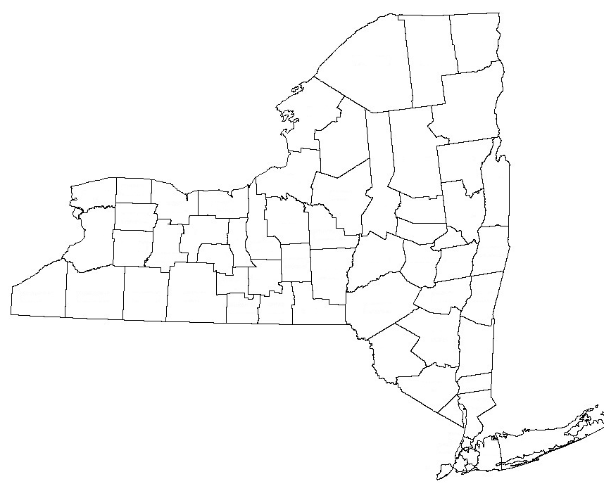




MLTC Transition Goals
November 2014: Chenango, Cortland, Livingston, Ontario, Steuben, Tioga, Tompkins, and Wayne
December 2014: Genesee, Orleans, Otsego, and Wyoming
January 2015: Allegany, Cattaraugus, Chautauqua, Chemung, Schuyler, Seneca, and Yates
February 2015: Clinton, Essex, Franklin,
Hamilton, Jefferson, Lewis,
and St. Lawrence

Slide 14
Conflict Free Evaluation and Enrollment Center Overview
In accordance with NY State’s Special Terms and Conditions (STC) #28, the State is required to develop an independent and conflict-free long term care services and supports (LTSS) evaluation process.
Effective October 1, 2014, the State implemented a Conflict- Free Evaluation and Enrollment Center (CFEEC) for individuals seeking Community-Based Long Term Care (CBLTC) services for more than 120 days.

Slide 15
CFEEC Update
The following information has been posted to the MRT website: www.health.ny.gov/health_care/medicaid/redesign/mrt_90.htm
A power point on CFEEC, a FAQ, a Fact Sheet, recorded Presentation, and Policy Document 14.06.

Slide 16
CFEEC Roll-out Schedule
CFEEC Implementation will be phased-in by Region.
Region 2 – November 2014:
Kings, Queens, Nassau, & Richmond
Region 3 – February 2015:
Westchester & Suffolk

Slide 17
CFEEC Roll-out Schedule Cont’d.
Region 4 - March 2015:
East Hudson (Columbia, Dutchess, Putnam)
Catskill (Rockland, Orange, Ulster, Greene, Sullivan)
Capital (Warren, Washington, Saratoga, Fulton, Montgomery, Schoharie, Schenectady, Albany, Rensselaer)
Other (Erie, Monroe, Onondaga)

Slide 18
CFEEC Roll-out Schedule Cont’d.
Region 5 – April 2015:
Southern Tier (Tompkins, Cortland, Tioga, Broome, Chenango, Otsego, Delaware)
Finger Lakes (Wayne, Ontario, Livingston, Seneca, Cayuga, Yates, Schuyler, Chemung, Steuben)
Western (Chautauqua, Cattaraugus, Allegany, Wyoming, Genesee, Orleans, Niagara)
Region 6 – May 2015:
Central (Jefferson, Oswego, Lewis, Oneida, Herkimer, Madison)
Northern (St. Lawrence, Franklin, Clinton, Essex, Hamilton)

Slide 19
CONTACT US
Questions and/or Comments:
CFEEC e-mail: CF.Evaluation.Center@health.ny.gov
MRT 90 website: http://www.health.ny.gov/health_care/medicaid/redesign/mrt_90.htm
Subscribe to our MRT listserv: http://www.health.ny.gov/health_care/medicaid/redesign/listserv.htm
‘Like’ the MRT on Facebook: http://www.facebook.com/NewYorkMRT
Follow the MRT on Twitter: @NewYorkMRT

