Slide 1
NY STATE OF HEALTH
THE OFFICIAL HEALTH PLAN MARKETPLACE
The Legal Aid Society
September 10, 2013
Rebecca Jackson
External Affairs Outreach and Marketing
rkj01@health.state.ny.us

Slide 2


Slide 3
NY STATE OF HEALTH WILL OPEN ON OCTOBER 1ST

Slide 4
What is NY State of Health?
Organized marketplace
  One-stop shopping for subsidized and unsubsidized coverage
  Easily compare health plan options
  The only place to check eligibility and apply for financial assistance
  Enroll in qualified health plans
Two programs
  Individual Marketplace
  Small Business Marketplace

Slide 5
NY State of Health Enrollment
Open Enrollment begins on October 1
Individuals may enroll in health plans during open enrollment October 1, 2013 - March 31, 2014) or with a qualifying event
Individuals who qualify for Medicaid/CHP may enroll any month of the year
Small employers may choose open enrollment dates for their employees any month of the year

Slide 6
Who Will Enroll In NY State Of Health?
Health Plan Marketplace enrollment is estimated to be
1.1 million New Yorkers
450,000
615,000

Slide 7
A STATE OF THE ART WEBPORTAL WILL MAKE IT EASY TO SHOP, COMPARE AND ENROLL

Slide 8
Online Enrollment
One portal will process applications for:
  Medicaid
  Child Health Plus
  Individual Marketplace
  Small Business Marketplace
System in rigorous testing for October 1 open enrollment

Slide 9
A FIRST CLASS CUSTOMER SERVICE CENTER WILL BE READY TO ANSWER QUESTIONS AND ENROLL PEOPLE.

Slide 10
Customer Service Call Center
Assistance available in over 170 languages
  Many staff will be bilingual and oral interpretation available for remaining languages.
Will take applications over the phone starting in October
Can refer to in-person assistors

Slide 11
CERTIFIED ENROLLMENT EXPERTS WILL PROVIDE IN-PERSON ASSISTANCE IN THE COMMUNITY AT COVENIENT LOCATIONS.

Slide 12
3 Types of In-Person Assistors
IPA/Navigators
Complete Applications
Certified Application Counselors
Complete Applications
No compensation from Marketplace
Insurance Brokers/Agents
Compensation from DOH grant program
Training and certification required
Complete Applications
Commission-based compensation
Training and certification required
Training and certification required
Serve Individuals and Small Business Marketplace
Choose to certify in Small Business Marketplace, Individual, or both
Notes:
50 Navigator organizations throughout the state
Hundreds of trained individuals that speak 48 different languages
Site schedules will be publicly available
5 day training and certification course
Insurance Brokers
More than 2,000 brokers have already completed continuing education for the Marketplace
Certified Application Counselors
Hospitals, healthcare providers, health plans, others

Slide 13
INDIVIDUALS AND SMALL BUSINESSES WILL HAVE A CHOICE OF HIGH QUALITY, LOW COST PRIVATE HEALTH PLANS.

Slide 14
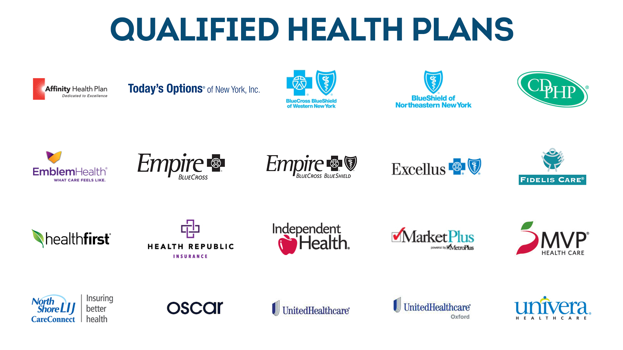
Qualified Health Plans
http://www.nystateofhealth.ny.gov/PlansMap

Slide 15
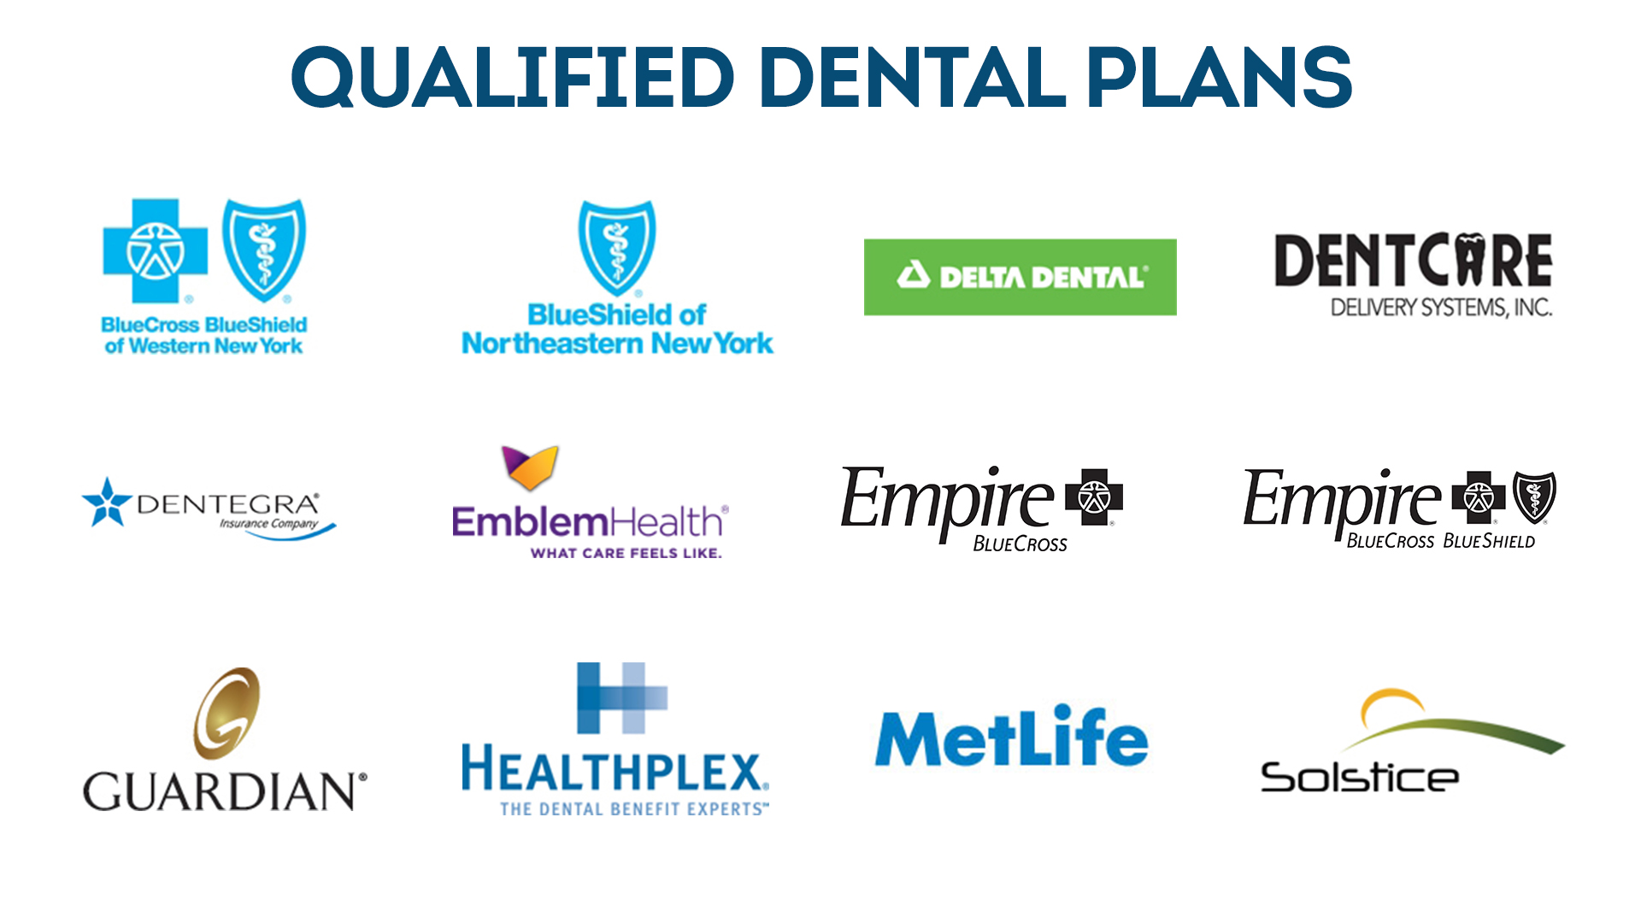
Qualified Dental Plans
http://www.nystateofhealth.ny.gov/PlansMap

Slide 16
Health Plan Highlights
Choice of plans in all areas of the State
Increased competition gives consumers new health plan options
Premiums for people who buy coverage for themselves and their families decreases by an average of 53% compared to today’s premiums
You will not be denied health insurance on the basis of a pre-existing condition
All plans are required to have adequate networks

Slide 17
Required Ten Essential Health Benefits
Preventive services will be offered at no cost to you
Ambulatory patient services
Emergency room services
Hospitalization
Maternity and newborn care
Mental health and substance abuse disorders
Prescription drugs
Rehabilitation and habilitation services and devices
Laboratory services
Preventive and wellness services and chronic disease management
Pediatric services, including oral and vision

Slide 18
Paying Individual Premiums
In the Individual Marketplace, QHP issuers cannot discriminate against individuals without bank accounts
Notes:
The following forms of payment will be accepted to pay premiums in the individual marketplace:
paper checks
cashier’s checks
money orders
EFT
all general-purpose pre-paid debit cards

Slide 19
A STATEWIDE AWARENESS CAMPAIGN HAS BEGUN. A MULTI-MEDIA ADVERTISING CAMPAIGN WILL BEGIN IN THE UPCOMING MONTHS.

Slide 20
Strategic Message
The NY State of Health is an online marketplace offering New Yorkers a gateway to affordable healthcare.
Comparing and finding the right plan for you and your family has never been easier. We’ve removed the hassle.
You can choose from a certified group of health insurance plans, giving you the peace of mind that you are prepared for life’s events.

Slide 21
Media
New name, logo and website unveiled
Creative campaign for TV, radio, print and “out-of-home”
Public relations campaign under way
Social media includes Twitter, Facebook, YouTube and Google Plus

Slide 22

Marketing Materials
Website (Now)
  Fact Sheets & Newsletter templates
  County-specific list of Navigator grantees
  County-specific list of Health Plans
  Financial Assistance Calculator
  Rack cards and Fact Sheets
  Posters
Enrollment Materials (Available for ordering Oct 1.)
  Rack cards and Fact Sheets
  Posters

Slide 23
How Can You Help?
Sponsor in-person or virtual events in the community
Distribute printed materials at events or at brick-and-mortar locations
Include information in established communication channels (e.g. organization newsletter)
Support online content (e.g. linking to the Exchange, sharing information online via Facebook, etc.)
Assist clients by providing referrals to the enrollment website, call center, or a certified Navigator or broker.
Identify additional outreach partners and share information with colleagues

Slide 24
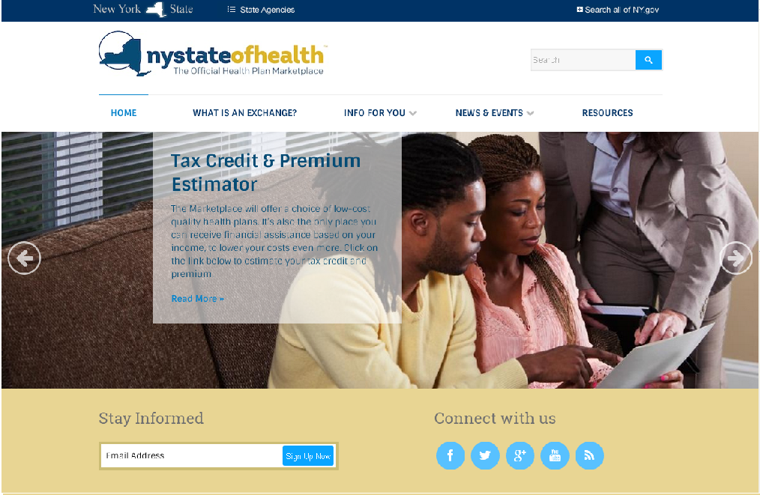

Slide 25
nystateofhealth.ny.gov
Coming October 1, 2013

