Slide 1
Marketplace Appeals
Legal Aid Society
September 10, 2013
Lisa Sbrana, Counsel

Slide 2
New applications for coverage October – December 2013
Medicaid and Family Health Plus applications submitted to and processed by local districts
Child Health Plus applications submitted to and processed by health plans
Qualified Health Plan applications for coverage and advance premium tax credits/cost-sharing reductions for coverage beginning 1/1/14 submitted to and processed by the Marketplace

Slide 3
New applications for coverage beginning January 1, 2014 through the Marketplace
MAGI-Medicaid
CHP
QHP and advance premium tax credits/cost-sharing reductions (includes premium assistance for those who would have been eligible for FHP)

Slide 4
Renewals for existing enrollees post January 1, 2014
Medicaid and FHP – processed by local districts using current rules through 3/31/14. Beginning 4/1/14, processed by local districts using MAGI-like budgeting in legacy system
CHP – processed through health plans
Once Marketplace system is fully automated and stable, existing enrollees will be transitioned to Marketplace at renewal

Slide 5
What to expect in during open enrollment
Centralized Call Center
Applications can be submitted online, by phone, in-person, by mail
Assistors and Navigators will be available in every county to provide individuals with in person help
Improved notices
Centralized Appeals for all eligibility determinations and robust informal resolutions process.

Slide 6





Individual enrollment online experience
Individual, or Authorized Representative
Application / Account
Management
Verification
Eligibility Determination
Plan Selection
Enrollment /
Other Processing
Create
NY-HX Account
Apply MAGI Rules
Send Enrollment to QHP
Online
Create Application / Demographics
Apply Program Specific / Special Rules
Send Enrollment to Medicaid / CHIP
Apply for Coverage
Verify at Federal Hub
Phone
Print and Mail Notices
Build Household / Income
Apply for Assistance
Verify Through NYS Interfaces
Display Eligibility Results
Select Coverage Plan(s)
Mail
Resolve Problems in Customer Support
Apply for Exemption
In-Person Assistor /
(Broker or Navigator)
Process Appeal
Customer Support

Slide 7
Appeals process dependent on where eligibility is determined
Medicaid – if eligibility determined by local district, appeals are processed through Office of Administrative Hearings
CHP – if eligibility determined by health plan, current appeals process used
All eligibility determinations made by Marketplace, have appeal through Marketplace

Slide 8
Marketplace appeals processes
Telephone hearing
  Individuals
  Small Business Employer
  Small Business Employees
Desk Review
  Small Business Employer (default)
  Small Business Employee (default)
  Large Employers

Slide 9
Appealable issues – Individual Marketplace
Eligibility for Insurance Affordability Programs
Eligibility for Qualified Health Plans
Large Employer
Marketplace fails to issue timely notice of eligibility determination

Slide 10
Appealable issues – Small Business Marketplace
Employer eligibility
  Located in NY
  50 or fewer employees
  Offering coverage to all full-time employees
  Marketplace fails to issue timely determination notice
Employee eligibility
  On employer roster
  Insurable relationships
  Marketplace fails to issue timely determination notice

Slide 11
Appeals to US Department of Health and Human Services
Appeals to HHS
  Individual Marketplace decisions regarding APTC
  Exemption determinations

Slide 12
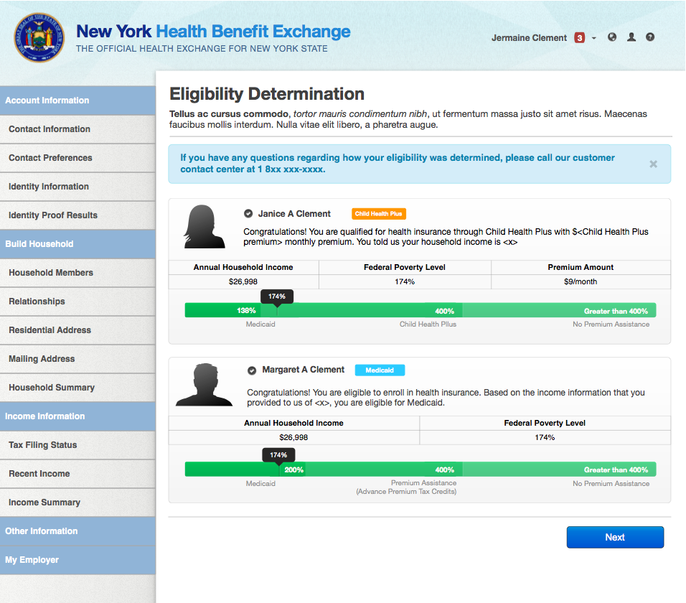

Slide 13
Appeals in the Marketplace
Appeal requests can be made
  Online
  Call Customer Service Center
  Mail
  Fax
Individual Marketplace – 60 days from date of determination to make request

Slide 14
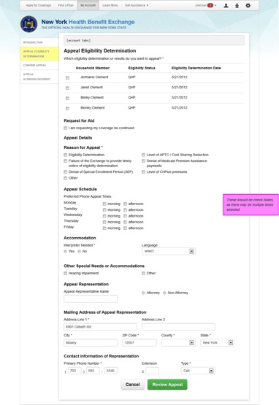
Online appeal request – Individual Marketplace

Slide 15
Informal Resolution Process
Available before requesting an appeal and while scheduling of hearing is pending
  Customer Service Specialists review determination with consumer, accept additional documentation/information
  Eligibility Specialists review new documentation/information; rerun eligibility based on submission

Slide 16
Informal Resolution Process
Appeal request date is preserved during IR
If favorable resolution reached, new eligibility determination is issued
Consumer withdraws hearing request or notice of disposition issued by Appeals Unit
If resolution not reached, proceed to hearing
IR does not add time to 90 day requirement for issuance of decision

Slide 17
Application information available at any time in online account
My account feature allows applicant to review at any time
  Information submitted in application
  Any supporting documents submitted with application
  Eligibility determination
  Notices issued electronically
  Appeal, if requested

Slide 18
Evidence Packets
First open enrollment – paper process
Authorization form included with all appeals acknowledgement notices
Signed authorization form required for Marketplace to release information received from state and federal data sources to consumer

Slide 19
Appeals – manual process through open enrollment
Acknowledgement notice automated – electronic or paper
All other appeals notices, evidence packet, and decision by mail

Slide 20
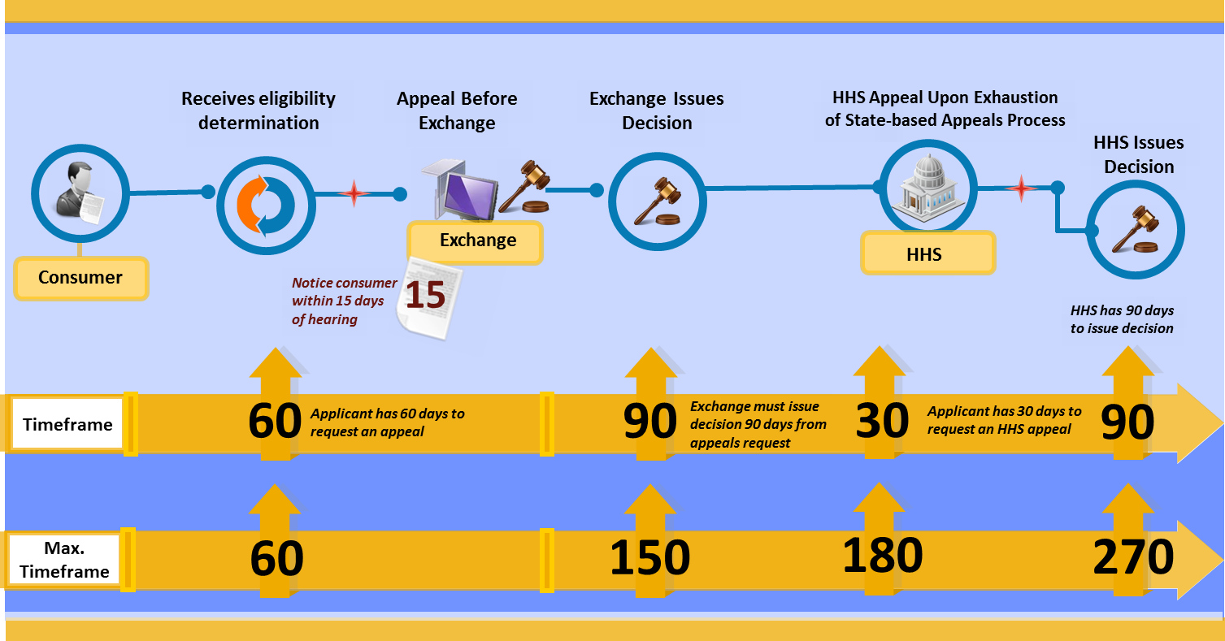
Appeals Timeline
Source: Manatt Health Solutions

Slide 21
Policy updates
http://www.nystateofhealth.ny.gov/resource/blueprint-application
http://www.nystateofhealth.ny.gov/resources

